Slide 1
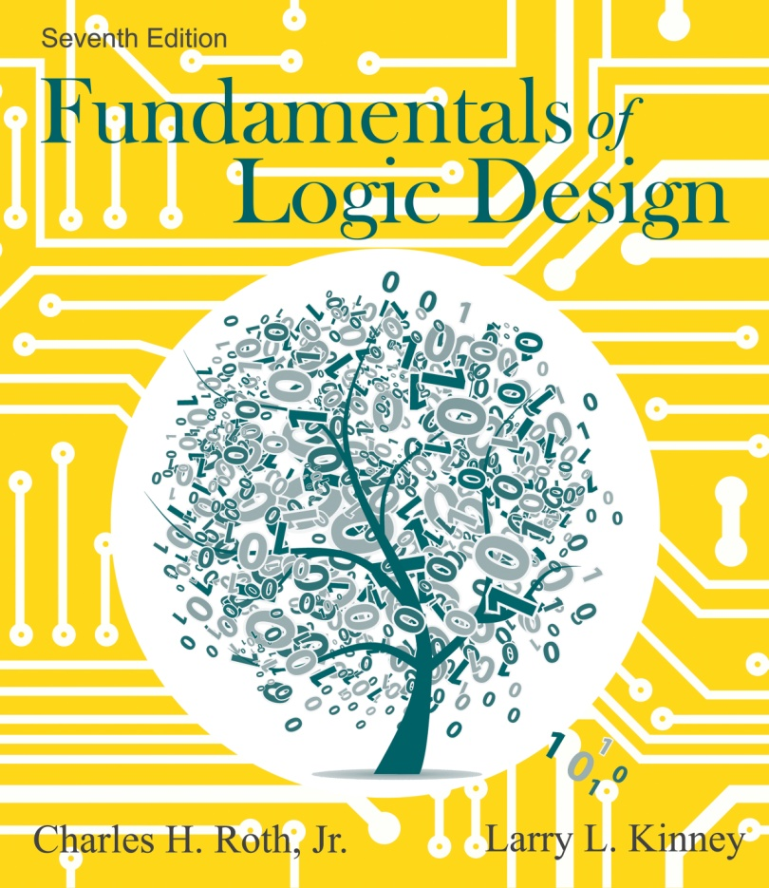

Unit 1
Introduction Number Systems and Conversion

Slide 2
This chapter in the book includes:
Objectives
Study Guide
1.1 Digital Systems and Switching Circuits
1.2 Number Systems and Conversion
1.3 Binary Arithmetic
1.4 Representation of Negative Numbers
1.5 Binary Codes
Problems

Slide 3
Learning Objectives
Introduction:
To be able to explain the difference between analog and digital systems, as well as why digital systems are capable of greater accuracy
To be able to understand the difference between combinational and sequential circuits
To be able to explain why two-valued signals and binary numbers are commonly used in digital systems

Slide 4
Learning Objectives
Number Systems and Conversion:
To be able to solve the following types of problems:
Given a positive integer, fraction, or mixed number in any base (2 through 16); convert to any other base. Justify the procedure using a power series expansion for the number.
Add, subtract, multiply, and divide positive binary numbers. Explain the addition and subtraction process in terms of carries and borrows.
Write negative binary numbers in sign and magnitude, 1’s complement, and 2’s complement forms. Add signed binary numbers using 1’s complement and 2’s complement arithmetic. Justify the methods used and identify overflows.
Represent a decimal number in binary-coded-decimal (BCD), 6-3-1-1 code, excess-3 code, etc. Given a set of weights, construct a weighted code.

Slide 5
Digital Systems and Switching Circuits
Digital and Analog Systems:
Digital systems are used extensively in computation and data processing, control systems, communications, and measurement.
In a digital system, physical quantities can only assume discrete values.
In an analog system, physical quantities or signals can vary continuously over a specified range.
In many cases digital systems can be designed so that for a given input, the output is exactly correct.
The output of an analog system might have an error ranging from a fraction of one percent to a few percents because these systems do not work with discrete quantities.

Slide 6
Digital Systems and Switching Circuits
Design of digital systems:
System design: breaking the overall system into subsystems and specifying the characteristics of each subsystem.
Logic design: determining how to interconnect basic logic building blocks to perform a specific function.
Circuit design: specifying the interconnection of specific hardware components to form a gate, flip-flop or other logic building block.

Slide 7
Digital Systems and Switching Circuits
Switching circuits:
A switching circuit has one or more inputs and one or more outputs which take on discrete values.
In combinational circuits, output values of circuit only depend on the present values of inputs, not past.
In sequential circuits, output values of circuit depend on both past and present input values. For this reason, sequential circuits are said to have “memory”, because they must remember past sequence of inputs.

Slide 8
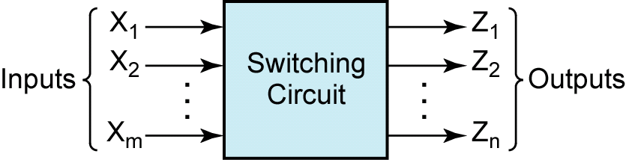
Digital Systems and Switching Circuits
Figure 1-1: Switching circuit

Slide 9
Digital Systems and Switching Circuits
Building Blocks of Switching Circuits:
Basic building block of combinational circuits: logic gate
Basic building block of sequential circuits: flip-flop
Switching devices used in digital systems are usually two-state devices, meaning the output can only assume one of two discrete values, i.e. relays, diodes and transistors.
Because the outputs of most switching devices assume only two different values, it is natural to use binary numbers internally in digital systems.

Slide 10
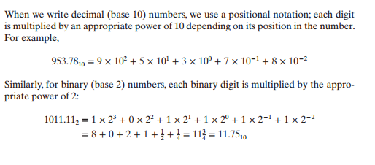
Number Systems and Conversion
Explanation of decimal and binary numbers:
When we write decimal (base 10) numbers, we use a positional notation; each digit is multiplied by an appropriate power of 10 depending on its position in the number.
When we write binary (base 2) numbers, each digit is multiplied by an appropriate power of 2 on its position in the number.

Slide 11
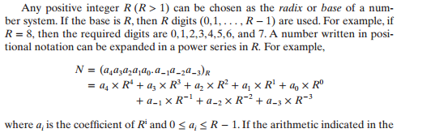
Number Systems and Conversion
Power series expansion in any number system of base R:

Slide 12

Number Systems and Conversion
Example:
Using the previous slide, the following conversion can be made from base 8 to base 10.
i=-1
a_{i}=3
i=2
a_{i}=1
i=0
a_{i}=7
i=1
a_{i}=4

Slide 13
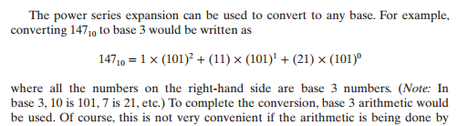
Number Systems and Conversion
Conversion to other bases:

Slide 14
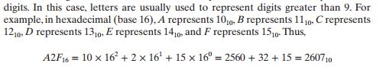
Number Systems and Conversion
Bases greater than 10:
For bases greater than 10, more than 10 symbols are needed to represent the digits.

Slide 15
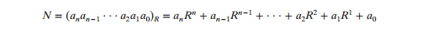
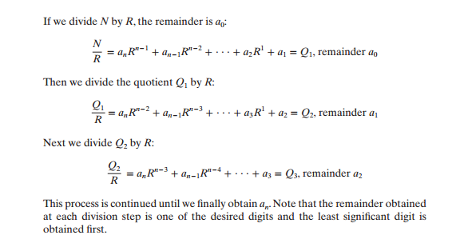
Number Systems and Conversion
Conversion of a decimal integer to base R using the division method:
The base R equivalent of a decimal integer N is as follows (from previous slides):

Slide 16
Number Systems and Conversion
Conversion of a decimal integer to base R using the division method (continued):

Slide 17
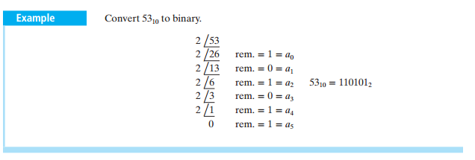
Number Systems and Conversion
Example 1: Conversion of decimal integer to binary

Slide 18
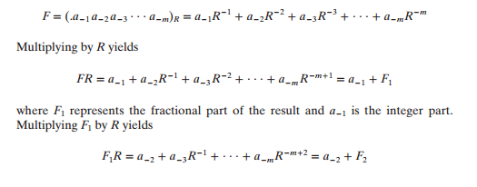
Number Systems and Conversion
Conversion of a decimal fraction F to base R using successive multiplications:

Slide 19
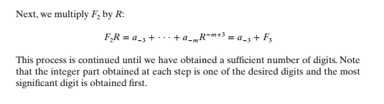
Number Systems and Conversion
Conversion of a decimal fraction F to base R using successive multiplications (continued):

Slide 20
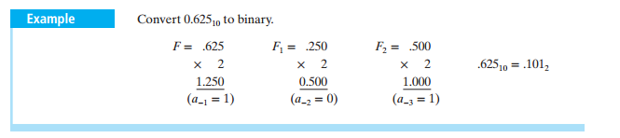
Number Systems and Conversion
Example 2: Conversion of a decimal fraction F to base R using successive multiplications

Slide 21
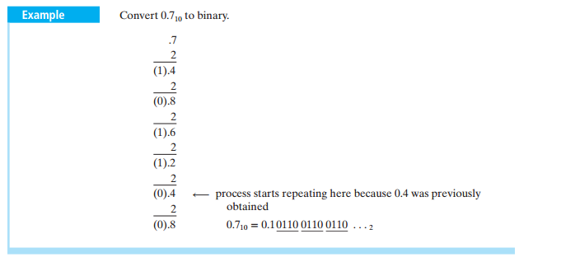
Number Systems and Conversion
Example 3: Conversion of a decimal fraction F to base R using successive multiplications

Slide 22
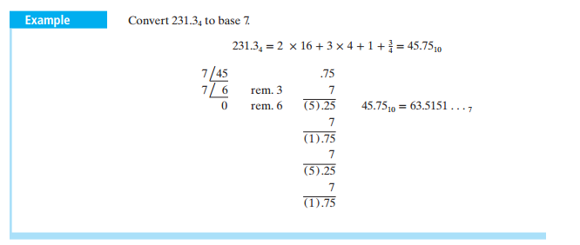
Number Systems and Conversion
Example 4: Conversion between two bases other than decimal

Slide 23
Number Systems and Conversion
Conversion from binary to hexadecimal and binary to octal:
Conversion from binary to hexadecimal (and conversely) can be done by inspection because each hexadecimal digit corresponds to exactly four binary digits (bits).
A similar conversion can be done from binary to octal, base 8 (and conversely), except each octal digit corresponds to three binary digits, instead of four.
100101101011010₂= 100 101 101 011 010 = 45532₈

Slide 24
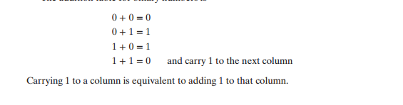
Binary Arithmetic
Introduction and Binary Addition:
For simplicity, arithmetic in digital systems is performed in binary (base 2).
Addition table for binary:

Slide 25
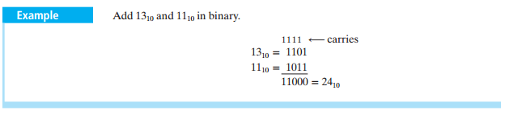
Binary Arithmetic
Example 5: Binary addition

Slide 26
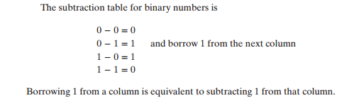
Binary Arithmetic
Binary Subtraction:
Subtraction table for binary:

Slide 27
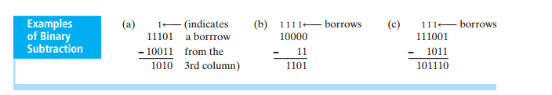
Binary Arithmetic
Example 6: Subtractions in Binary
Notice how in (b), the borrow propagates from column to column.

Slide 28

Binary Arithmetic
Binary Multiplication:
Multiplication table for binary:

Slide 29
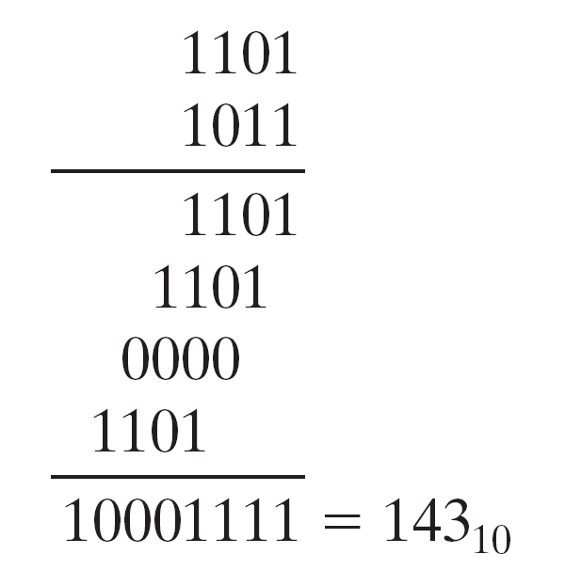
Binary Arithmetic
Example 7: Binary Multiplication
13₁₀ by 11₁₀ in binary:

Slide 30
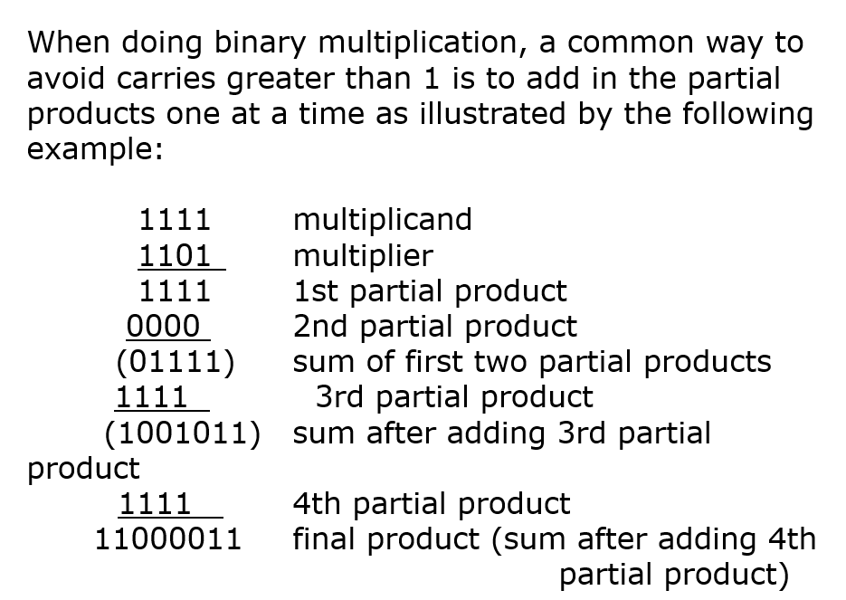
Binary Arithmetic

Slide 31
Binary Arithmetic
Binary Division:
Binary division is similar to decimal division, except it is much easier because the only two possible quotient digits are 0 and 1.
We start division by comparing the divisor with the upper bits of the dividend.
If we cannot subtract without getting a negative result, we move one place to the right and try again.
If we can subtract, we place a 1 for the quotient above the number we subtracted from and append the next dividend bit to the end of the difference and repeat this process with this modified difference until we run out of bits in the dividend.

Slide 32
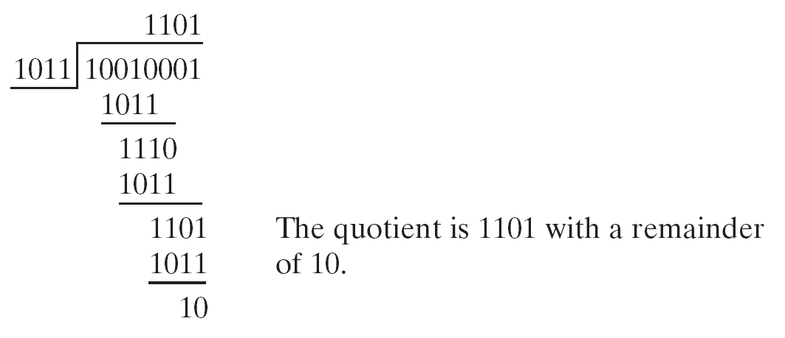
Binary Arithmetic
Example 8: Binary Division
145₁₀ by 11₁₀ in binary

Slide 33
Representation of Negative Numbers
Common methods of representing both positive and negative numbers are:
Sign and magnitude
2’s complement
1’s complement
In each of these methods, the leftmost bit of a number is 0 for positive numbers and 1 for negative numbers.

Slide 34
Representation of Negative Numbers
3 Systems for representing negative numbers in binary- Overview:
Sign & Magnitude: Most significant bit is the sign
Ex: – 5₁₀ = 1101₂
2’s Complement: N* = 2^{n} - N
Ex: – 5₁₀ = 2⁴ – 5 = 16 – 5 = 11₁₀ = 1011₂
1’s Complement: = (2^{n} – 1) - N
Ex: – 5₁₀ = (2⁴ – 1) – 5 = 16 – 1 – 5 = 10₁₀ = 1010₂

Slide 35
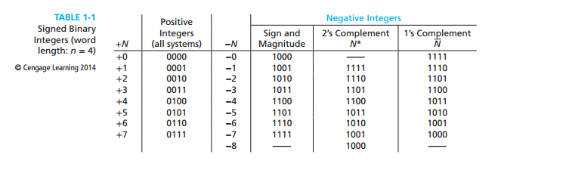
Representation of Negative Numbers
Sign & Magnitude:
Most significant bit is the sign
Ex: – 5₁₀ = 1101₂

Slide 36
Representation of Negative Numbers
2’s compliment:
Positive number, N, is represented by a 0 followed by the magnitude of N as in the sign and magnitude system
For negative numbers, -N, 2’s compliment is represented by N*, as follows:
N* = 2^{n} - N
Where the word length is n bits.

Slide 37
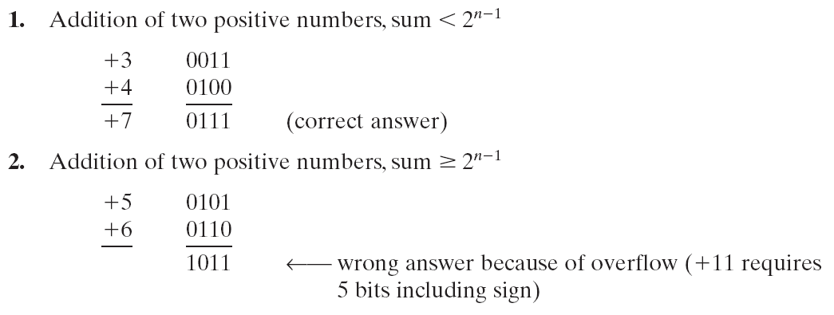
Representation of Negative Numbers
Example 9: 2’s Compliment Addition

Slide 38
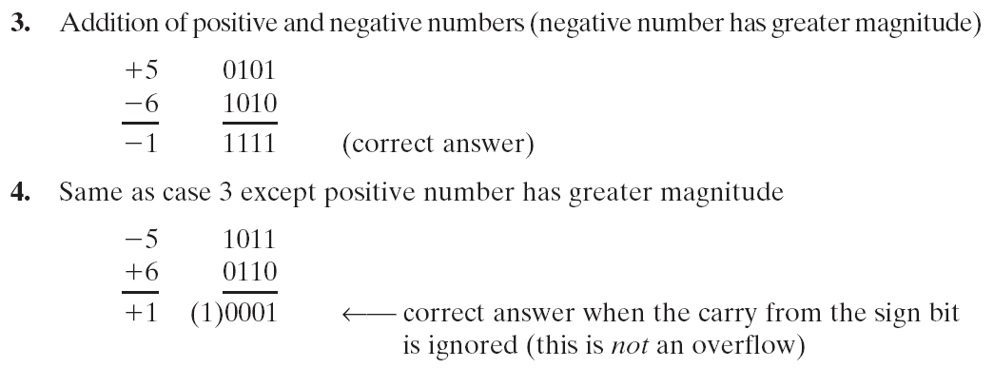
Representation of Negative Numbers
Example 9: 2’s Compliment Addition (continued)

Slide 39
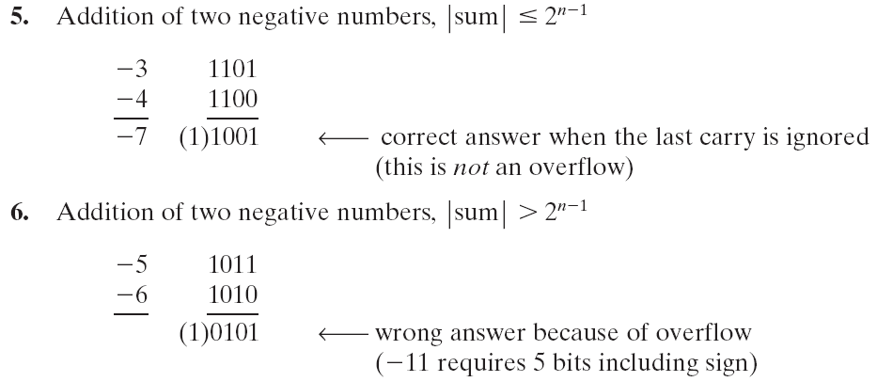
Representation of Negative Numbers
Example 9: 2’s compliment Addition (continued)

Slide 40

Representation of Negative Numbers
1’s compliment:
Ex: – 5₁₀ = (2⁴ – 1) – 5 = 16 – 1 – 5 = 10₁₀ = 1010₂
End around carry: In one’s compliment, the last carry is not discarded as it is in 2’s compliment, but rather added to the n-bit sum in the position furthest to the right.

Slide 41
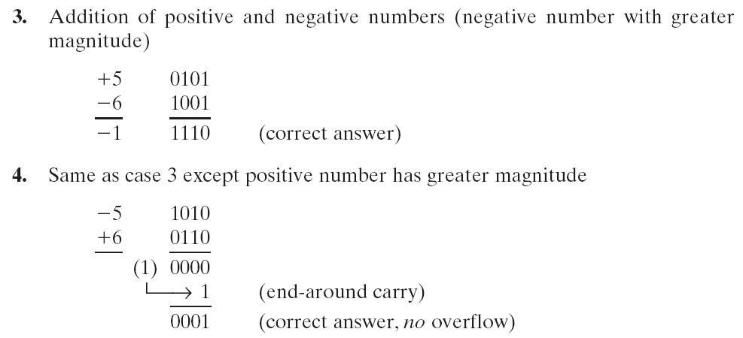
Representation of Negative Numbers
Example 10: 1’s compliment Addition

Slide 42
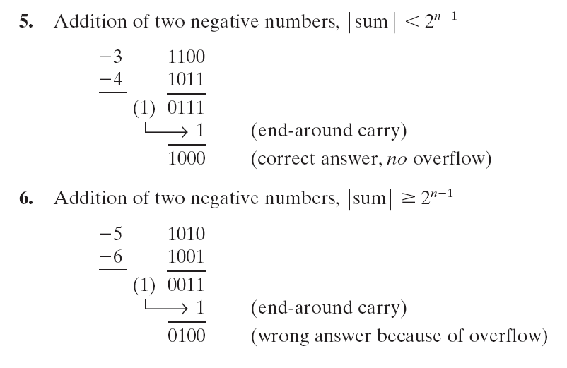
Representation of Negative Numbers
Example 10: 1’s compliment Addition (continued)

Slide 43
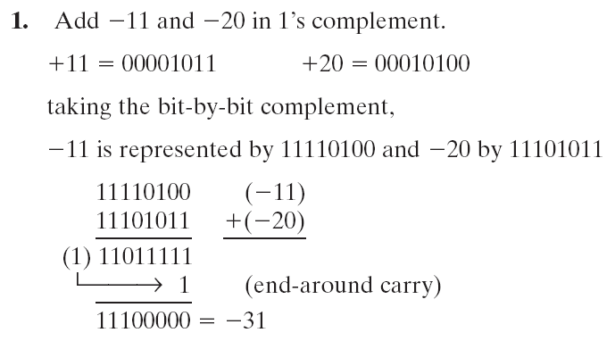
Representation of Negative Numbers
Example 10: 1’s compliment Addition (continued)

Slide 44
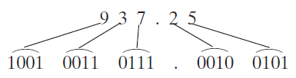
Binary Codes
Although most large computers work internally with binary numbers, the input-output equipment generally uses decimal numbers.
Because most logic circuits only accept two-valued signals, the decimal numbers must be coded in terms of binary signals.
In the simplest form of binary code, each decimal digit is replaced by its binary equivalent. For example, 937.25 is represented by:

Slide 45
Binary Codes
Table 1–2. Binary Codes for Decimal Digits

Slide 46
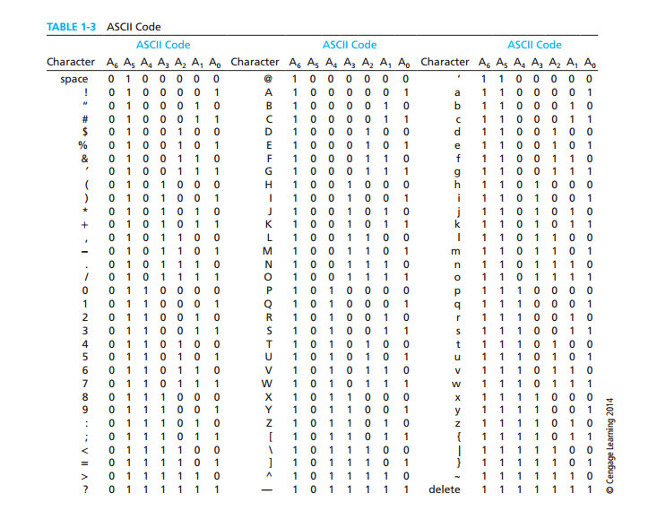
Binary Codes

